Slide 1
Recursion in MIPS
CSE-3109 Computer Architecture Lecture 9

Slide 2
Introduction
Recursion occurs when a function/procedure calls itself.
Following is the C++ code of a program that performs the factorial operation through recursion.
It has two parts. The first part is the main part of the program that takes some integer as the input from the user, passes this number on to the factorial function, gets the result back from the factorial function and displays the result.

Slide 3
Introduction
The second part is the factorial procedure which performs the factorial operation by recursively calling itself until the base case is reached, at which point the nested calls to the factorial procedure start returning.

Slide 4
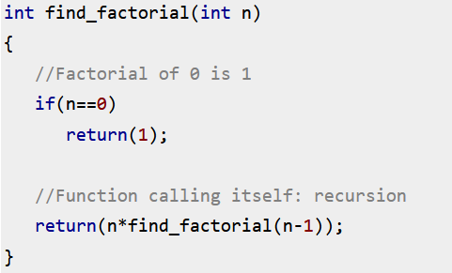
Introduction

Slide 5
Recursion example in MIPS
int fact (int n)
{
if (n<1) return 1;
else
return (n*fact(n-1));
}
The parameter variable n corresponds to the argument register $a0. The compiled program starts with the label of the procedure and then saves two registers on the stack, the return address and $a0:
fact:
addi $sp, $sp, –8 # adjust stack for 2 items
sw $ra, 4($sp) # Push the returning address in the stack
sw $a0, 0($sp) # Push the variable $a0 variable to the stack

Slide 6
Recursion example in MIPS
int fact (int n)
{
if (n<1) return 1;
else
return (n*fact(n-1));
}
The next two instructions test whether n is less than 1, going to L1 if n ≥ 1.
slti $t0,$a0,1 # test for n < 1 (slti=set on less than)
beq $t0,$zero, L1 # if n >= 1, go to L1 (branch if
registers are equal instruction (beq))

Slide 7
slti MIPS Instruction Format
slti $t0,$a0,1 # test for n (slti=set on less than)
If ($a0<1) set $t0=1 ; else $t0=0

Slide 8
Recursion example in MIPS (??)
int fact (int n)
{
if (n<1) return 1;
else
return (n*fact(n-1));
}
If n is less than 1, fact returns 1 by putting 1 into a value register: it adds 1 to $v0. It then pops the two saved values off the stack and jumps to the return address:
addi $v0,$zero,1 # return 1 (the base condition)
lw $a0, 0($sp) #Pop the value of $a0 from the stack
lw $ra, 4($sp) # restore the return address
addi $sp,$sp,8 # pop 2 items off stack
jr $ra # return to caller (main)

Slide 9
Recursion example in MIPS
int fact (int n)
{
if (n<1) return 1;
else
return (n*fact(n-1));
}
If n is not less than 1, the argument n is decremented and then fact is called again with the decremented value:
L1:
addi $a0,$a0, –1 # n >= 1: argument gets (n – 1)
jal fact # call fact with (n – 1)
jal: Use when making procedure call. This saves the return address in $ra

Slide 10
Recursion example in MIPS
int fact (int n)
{
if (n<1) return 1;
else
return (n*fact(n-1));
}
Code After “jal fact”
0×BC: lw $ra, 4($sp) # restoring the value of
return address from the stack
lw $a0, 0($sp) # restoring the local variable from the stack
addi $sp, $sp, 8 # adjust stack pointer to pop 2 items

Slide 11
Recursion example in MIPS
int fact (int n)
{
if (n<1) return 1;
else
return (n*fact(n-1));
}
mul $v0,$a0,$v0 # return n * fact (n – 1)
If The recursion is rewinding this is going to be executed otherwise it will not be executed. The recursion will calling itself again and gain but it would not get to this line. But when the function is returning this line will be executed. And that’s how, we get the final answer.

Slide 12
Recursion example in MIPS
int fact (int n)
{
if (n<1) return 1;
else
return (n*fact(n-1));
}
jr $ra
This is going jump back to the previous address (main function).

Slide 13
Recursion example in MIPS
int fact (int n)
{
if (n<1) return 1;
else
return (n*fact(n-1));
}
Let us consider the program for the number. The result is 5040
The first value pushed on to the stack is the value of $ra which contains the return address to the main.
The second value pushed on to the stack is the value in $a0 for the first time which is n = 7.

Slide 14
Recursion example in MIPS
int fact (int n)
{
if (n<1) return 1;
else
return (n*fact(n-1));
}
Let us consider the program for the number. The result is 5040
The third value pushed on to the stack is the value of $ra which contains the return address within the fact function after the jal fact call from within fact.
The fourth value pushed on to the stack is the value in $a0 after doing (n-1), i.e., 6 for this example.

Slide 15
Recursion example in MIPS
int fact (int n)
{
if (n<1) return 1;
else
return (n*fact(n-1));
}
The stack grows until the recursion meets the base condition.
Until that time, on each function call the value of $a0 is decremented by 1 to perform (n-1) and the function fact is called to perform fact(n-1).
Each time the value of $ra and $a0 are pushed on to the stack before performing any other operation.

Slide 16
Recursion example in MIPS
int fact (int n)
{
if (n<1) return 1;
else
return (n*fact(n-1));
}
Once the base condition is met, recursive procedure calls start to return with appropriate value in $v0 and on each return the respective values of $a0 and $ra are popped in proper order until we reach the main, thus the stack shrinks.
At this time the stack is at its original state from where we started.

Slide 17
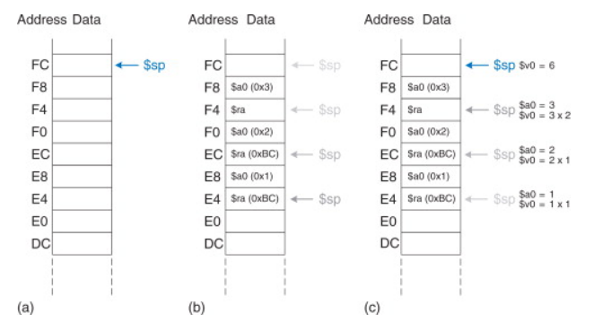
Recursion example
Stack during factorial function call when n=3
(a)Before call
(b) After last recursive call
(c) After return

Slide 18
Recursion example
We assume that $sp initially points to 0xFC.
On the first call, factorial saves $a0 (holding n = 3) at 0xF8 and $ra at 0xF4 (which contains the return address to the main).
The function then changes $a0 to n = 2 and recursively calls factorial(2), making $ra hold 0xBC. (slide 10)
On the second call, it saves $a0 (holding n = 2) at 0xF0 and $ra at 0xEC. This time, we know that $ra contains 0xBC.

Slide 19
Recursion example
The function then changes $a0 to n = 1 and recursively calls factorial(1).
On the third invocation, it saves $a0 (holding n = 1) at 0xE8 and $ra at 0xE4. This time, $ra again contains 0xBC.
The third invocation of factorial returns the value 1 in $v0 and deallocates the stack frame

Slide 20
Recursion example
The second invocation restores n to 2, restores $ra to 0xBC,deallocates the stack frame, and returns $v0 = 2 × 1 = 2 to the first invocation.
The first invocation restores n to 3, restores $ra to the return address of the caller, deallocates the stack frame, and returns $v0 = 3 × 2 = 6.
When factorial returns to the caller, the stack pointer is in its original position (0xFC), all of the preserved registers hold their original values. $v0 holds the return value, 6.

Slide 21
References
https://www.sciencedirect.com/topics/computer-science/factorial-function
https://www.youtube.com/watch?v=B6ky4Weahm4
https://www.youtube.com/watch?v=B6ky4Weahm4

Slide 22
End

